Slide 1
CUDA Image Processing
Parallel Programming for Machine Learning
LM Intelligenza Artificiale
A.A. 2023/2024
Piqué Gregorio
24/02/2024

Slide 2
CUDA Image Processing
24/02/2024
Indice
Introduzione
Convoluzione
CUDA
Implementazione
Risultati
Conclusioni

Slide 3
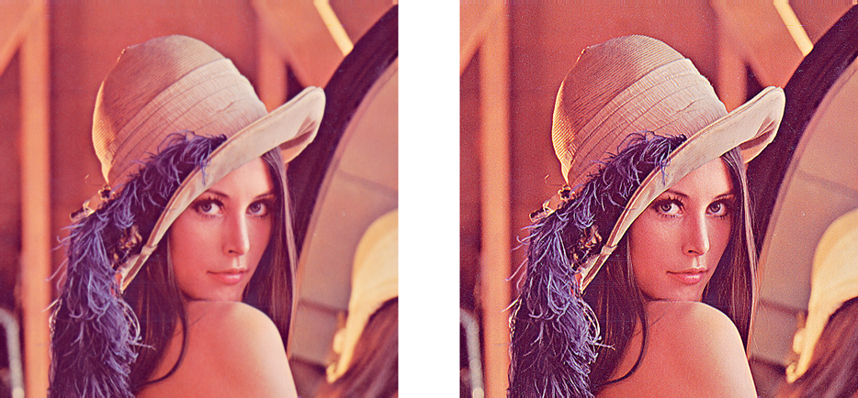
CUDA Image Processing
24/02/2024
Introduzione
Progetto di Image Processing
Algoritmi per elaborazione di immagini
Kernel come matrice di filtri
Sviluppo con CUDA

Slide 4
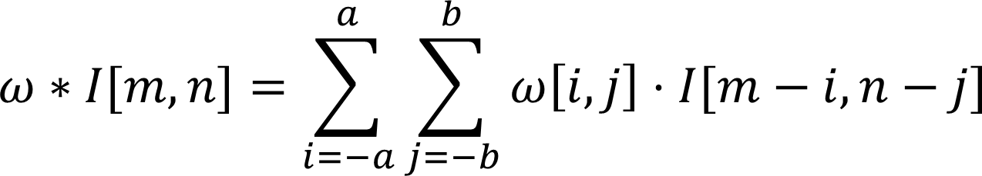
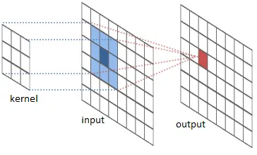
CUDA Image Processing
24/02/2024
Convoluzione
Operazione tra due funzioni
Immagine di input combinata con il kernel

Slide 5
CUDA Image Processing
24/02/2024
CUDA
Sviluppo con CUDA
Parallelizzazione su GPU
Codice host e device
Device memory model eterogeneo

Slide 6
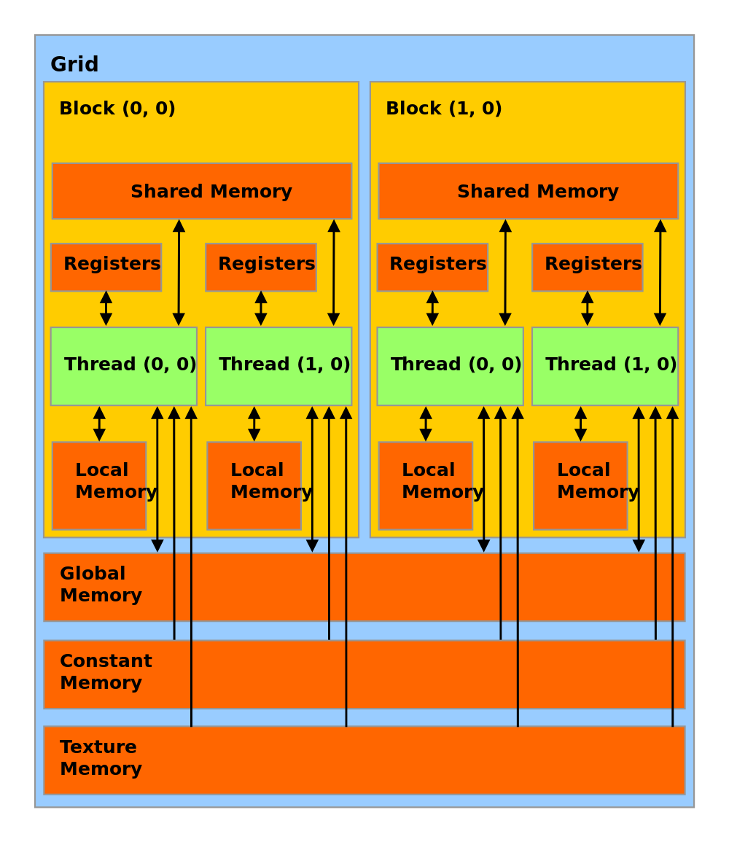
CUDA Image Processing
24/02/2024
Global memory
Accessibile da tutti
Grande capacità
Accesso lento

Slide 7
CUDA Image Processing
24/02/2024
Constant memory
Accessibile da tutti
Sola lettura
Accesso veloce

Slide 8
CUDA Image Processing
24/02/2024
Shared memory
Accesso per blocco
Capacità ridotta
Accesso veloce

Slide 9
CUDA Image Processing
24/02/2024
Implementazione
Classi:
Image
Kernel
Convolution
Enumerativi:
FilterType
ExecutionMode

Slide 10
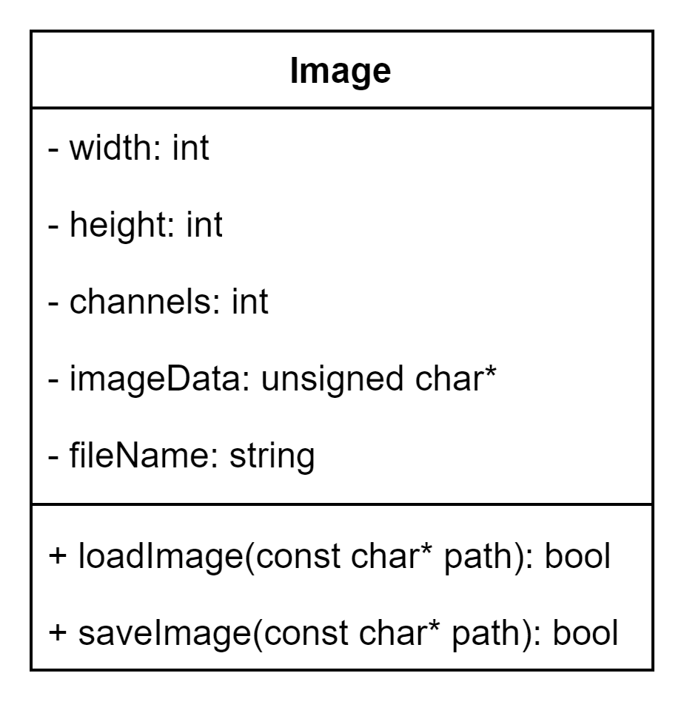
CUDA Image Processing
24/02/2024
Image

Slide 11
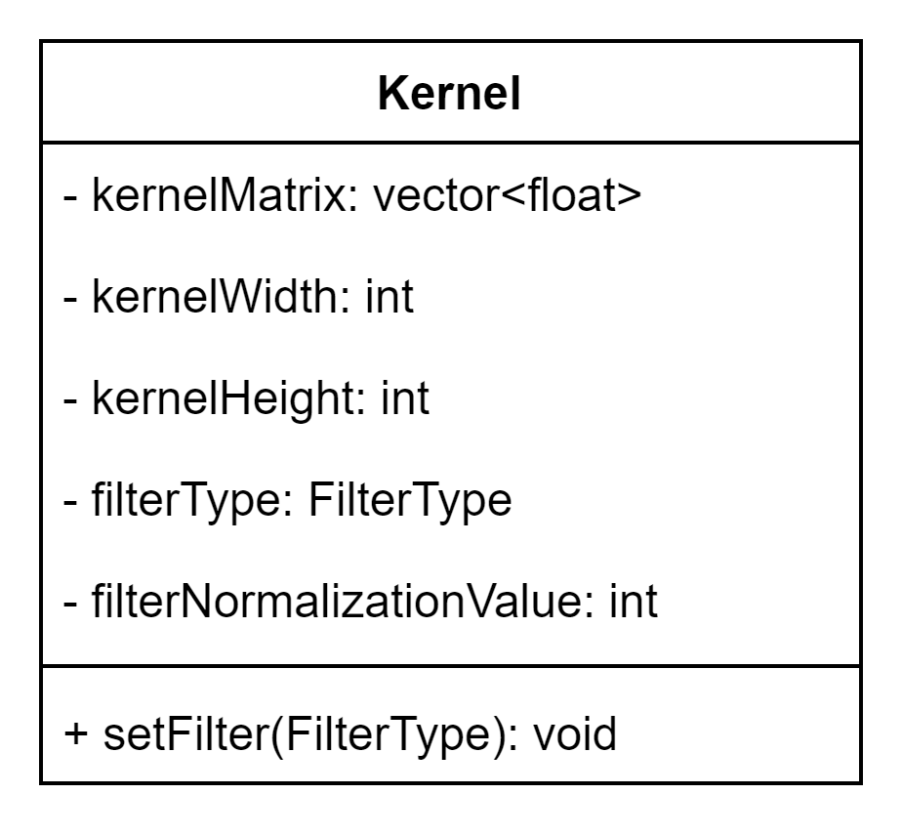
CUDA Image Processing
24/02/2024
Kernel

Slide 12
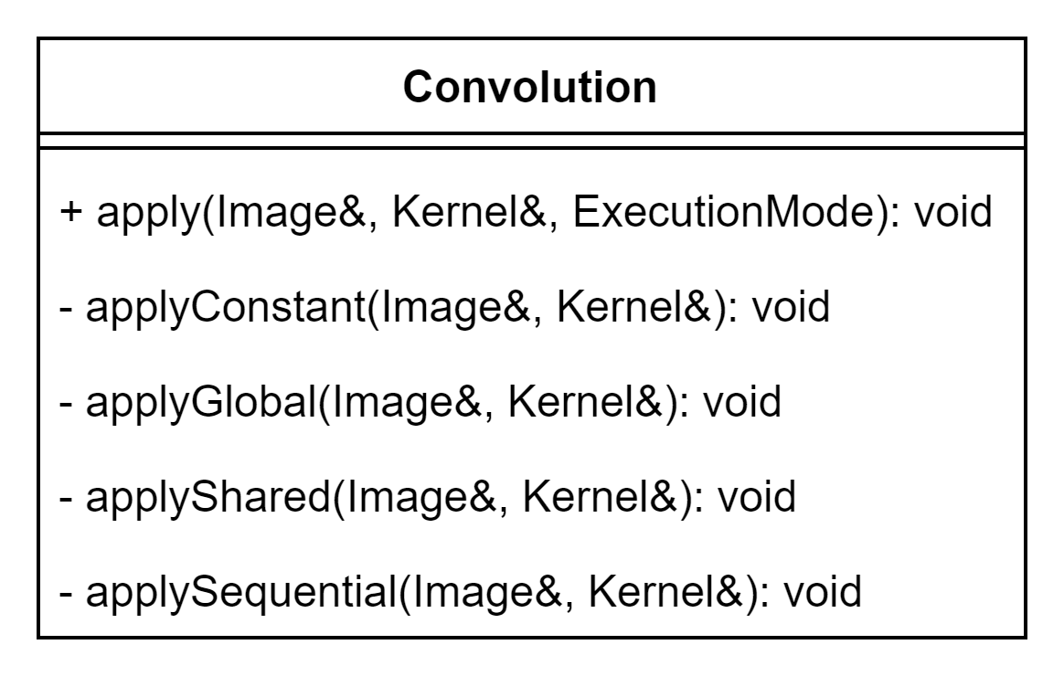
CUDA Image Processing
24/02/2024
Convolution

Slide 13
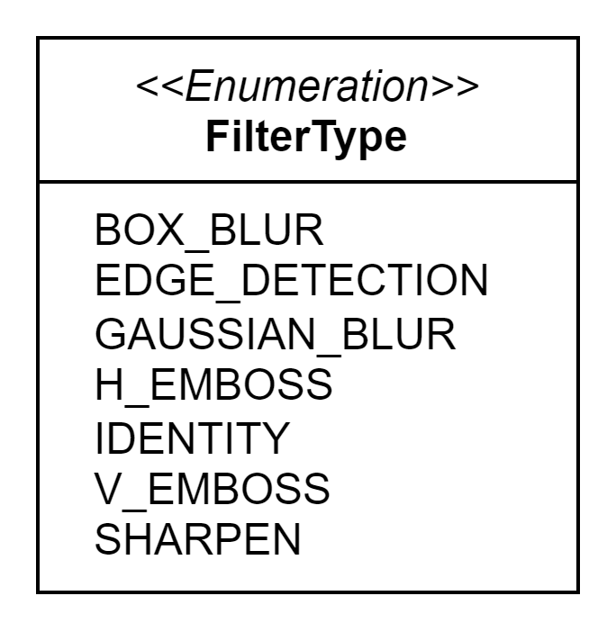
CUDA Image Processing
24/02/2024
FilterType

Slide 14
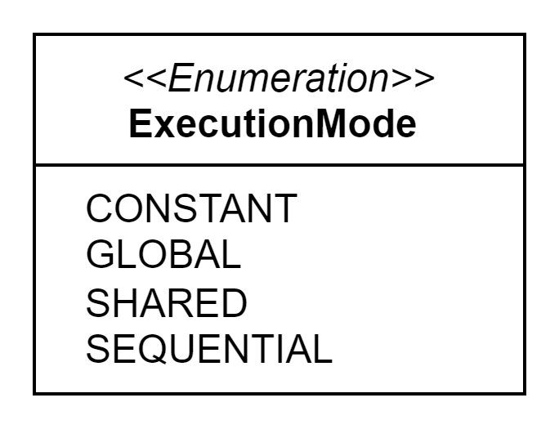
CUDA Image Processing
24/02/2024
ExecutionMode

Slide 15
CUDA Image Processing
24/02/2024
Codice Sorgente
Versione sequenziale
Varianti versione parallela:
Solo Global memory
Constant memory per filtro
Shared memory per immagine, Constant memory per filtro

Slide 16
CUDA Image Processing
24/02/2024
Variante Shared Memory
void Convolution::applyShared(Image& image, Kernel& kernel) {
// get the total size of the image and kernel mask
size_t imageSize = image.getTotalSize(true);
size_t kernelSize = kernel.getTotalSize(true);
// copy the kernel mask to the constant memory
cudaError_t cudaError = cudaMemcpyToSymbol(KERNEL_MASK, kernel.getKernelFilter(), kernelSize);
// check for CUDA errors
if (cudaError != cudaSuccess) {
fprintf(stderr, "cudaMemcpyToSymbol failed: %s\n", cudaGetErrorString(cudaError));
return;
}

Slide 17
CUDA Image Processing
24/02/2024
// allocate device memory and copy input and output images
unsigned char* dev_imgIn;
unsigned char* dev_imgOut;
unsigned char* imgOut = (unsigned char*)malloc(imageSize);
cudaMalloc((void**)&dev_imgIn, imageSize);
cudaMalloc((void**)&dev_imgOut, imageSize);
cudaMemcpy(dev_imgIn, image.getImageData(), imageSize, cudaMemcpyHostToDevice);
cudaMemcpy(dev_imgOut, imgOut, imageSize, cudaMemcpyHostToDevice);
// define the grid and block dimensions
dim3 gridSize(ceil(image.getWidth() / (float)TILE_SIZE), ceil(image.getHeight() / (float)TILE_SIZE), 1);
dim3 blockSize(BLOCK_SIZE, BLOCK_SIZE);
// calculate shared memory size
size_t sharedMemorySize = BLOCK_SIZE * BLOCK_SIZE * image.getChannels() * sizeof(unsigned char);

Slide 18
CUDA Image Processing
24/02/2024
// launch the CUDA kernel for shared memory convolution
sharedKernel << <gridSize, blockSize, sharedMemorySize >> > (dev_imgIn, dev_imgOut, image.getWidth(), image.getHeight(), image.getChannels(), kernel.getFilterNormalizationValue());
// check for CUDA errors
cudaError = cudaGetLastError();
if (cudaError != cudaSuccess) {
printf("CUDA error: %s", cudaGetErrorString(cudaError));
}
// synchronize device to ensure completion of the kernel
cudaDeviceSynchronize();
// copy the image result back to the host and update the image data
cudaMemcpy(imgOut, dev_imgOut, imageSize, cudaMemcpyDeviceToHost);
image.setImageData(imgOut);
// free allocated device memory
cudaFree(dev_imgIn);
cudaFree(dev_imgOut);
}

Slide 19
CUDA Image Processing
24/02/2024
Funzione CUDA - Variante Shared Memory
__global__ void sharedKernel(unsigned char* in, unsigned char* out, int width, int height, int channels, int pixelNormValue)
{
// variable used for storing a part of the image in the shared memory
extern __shared__ unsigned char sharedData[];
// get thread indices
int tx = threadIdx.x;
int ty = threadIdx.y;
// get the output indices
int row_o = ty + blockIdx.y * TILE_SIZE;
int col_o = tx + blockIdx.x * TILE_SIZE;
// shift to obtain input indices considering the convolution mask size
int row_i = row_o - (KERNEL_SIZE / 2);
int col_i = col_o - (KERNEL_SIZE / 2);

Slide 20
CUDA Image Processing
24/02/2024
// all threads participate in data loading
// load tile elements from the input image into shared memory
for (int c = 0; c < channels; c++)
{
unsigned char pixelVal = 0;
// ensure that the input indices are within the valid image range
row_i = min(height - 1, max(row_i, 0));
col_i = min(width - 1, max(col_i, 0));
// store the loaded pixel value in the shared memory tile
sharedData[(ty * BLOCK_SIZE + tx) * channels + c] = in[(row_i * width + col_i) * channels + c];
}
// wait for all tile elements to be loaded
__syncthreads();
Notes:
design 2:
- dimensione blocco = dimensione tile di input
- tutti i thread partecipano nel caricare dati di input
- non tutti i thread partecipano nella convoluzione per il calcolo del valore di output

Slide 21
CUDA Image Processing
24/02/2024
// only compute if the current thread is part of an output tile
// perform convolution using the tile in shared memory and mask filter
if (tx < TILE_SIZE && ty < TILE_SIZE && row_o < height && col_o < width) {
for (int c = 0; c < channels; c++)
{
float pixelVal = 0;
// iterate over the elements of the convolution mask
for (int y = 0; y < KERNEL_SIZE; y++)
for (int x = 0; x < KERNEL_SIZE; x++)
pixelVal += sharedData[((y + ty) * BLOCK_SIZE + x + tx) * channels + c] * KERNEL_MASK[y * KERNEL_SIZE + x];
// normalize the pixel value, then store it in the output image
pixelVal = min((float)CHANNELS_MAX_VALUE, max(pixelVal + pixelNormValue, 0.0f));
out[(row_o * width + col_o) * channels + c] = pixelVal;
}
}
}
}

Slide 22
CUDA Image Processing
24/02/2024
Risultati
Immagini processabili con diversi filtri
Risultati salvati su file .png
Immagini test da 100x100px a 10000x6000px
Performance test

Slide 23
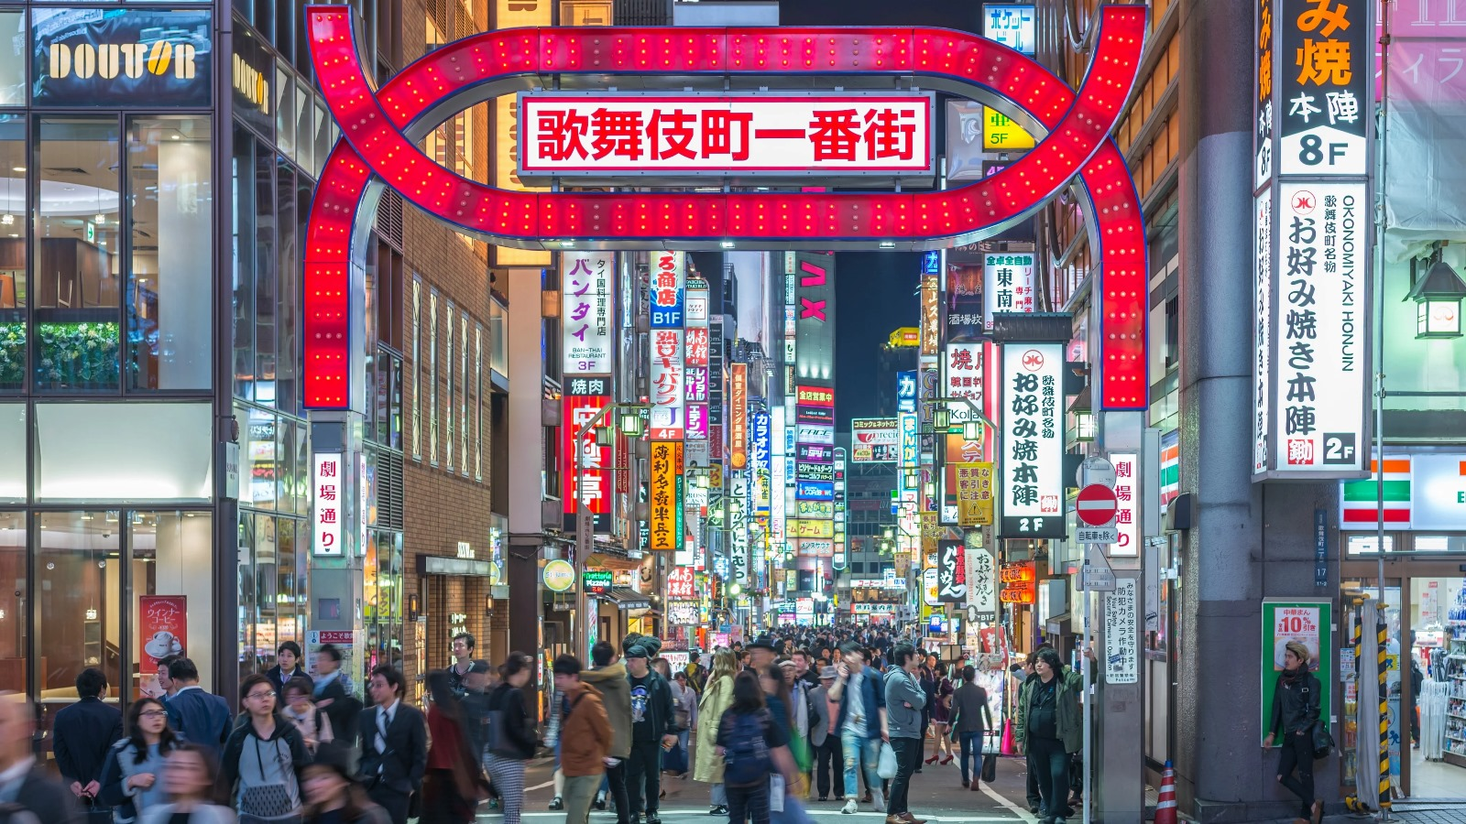
CUDA Image Processing
24/02/2024
Esempio Edge Detection

Slide 24
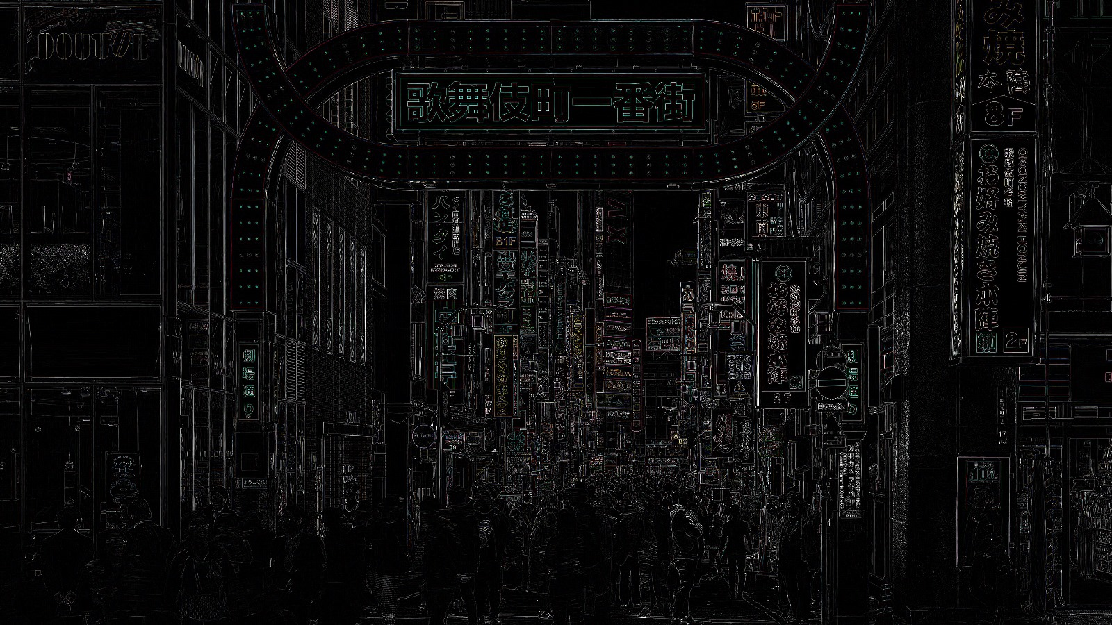
CUDA Image Processing
24/02/2024
Esempio Edge Detection

Slide 25
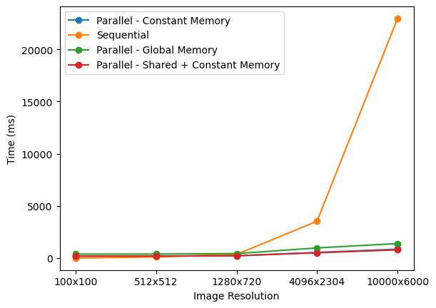
CUDA Image Processing
24/02/2024
Performance Globali

Slide 26
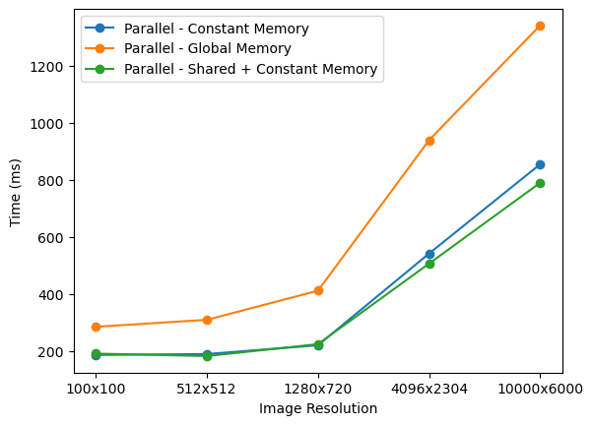
CUDA Image Processing
24/02/2024
Varianti Parallele

Slide 27
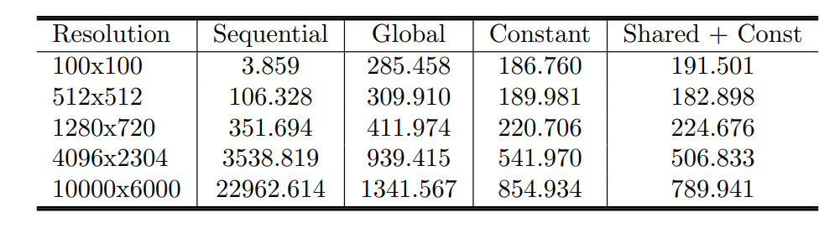
CUDA Image Processing
24/02/2024
Tempi Esecuzione Generali

Slide 28
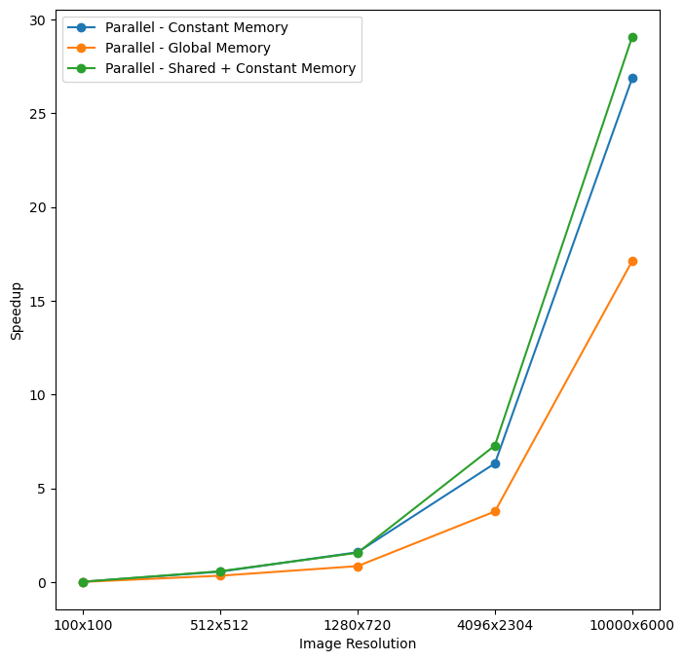
CUDA Image Processing
24/02/2024
Speedup

Slide 29
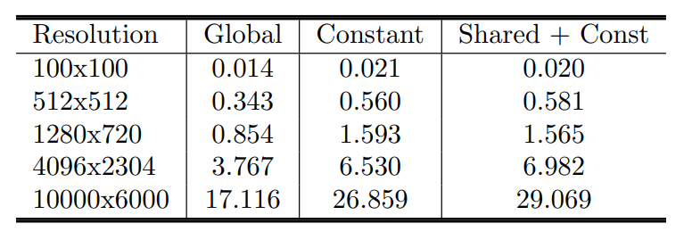
CUDA Image Processing
24/02/2024
Speedup Generale

Slide 30
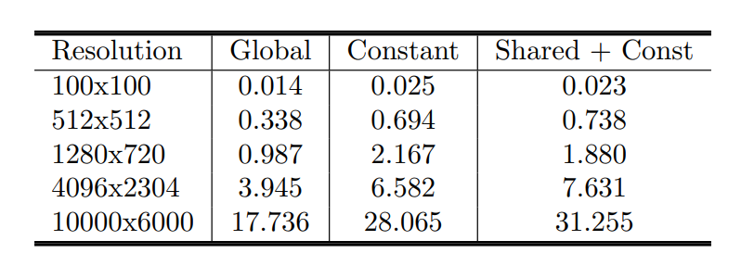
CUDA Image Processing
24/02/2024
Speedup Con Blocchi CUDA 32x32

Slide 31
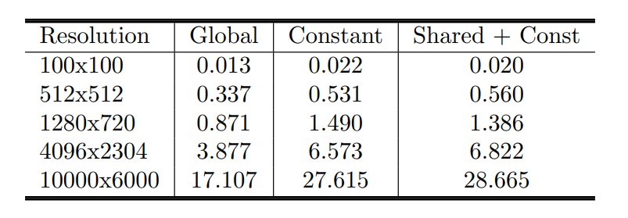
CUDA Image Processing
24/02/2024
Speedup Con Blocchi CUDA 16x16

Slide 32
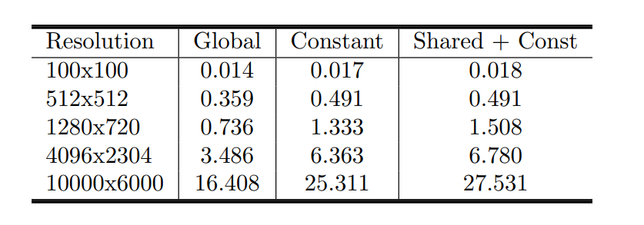
CUDA Image Processing
24/02/2024
Speedup Con Blocchi CUDA 8x8

Slide 33
CUDA Image Processing
24/02/2024
Conclusioni
Kernel Image Processing in CUDA
Parallelizzazione su GPU
Implementazione sequenziale e parallela
Varianti parallele usando memorie diverse
Speedup medio di 24,5 con immagini grandi

